Slide 1
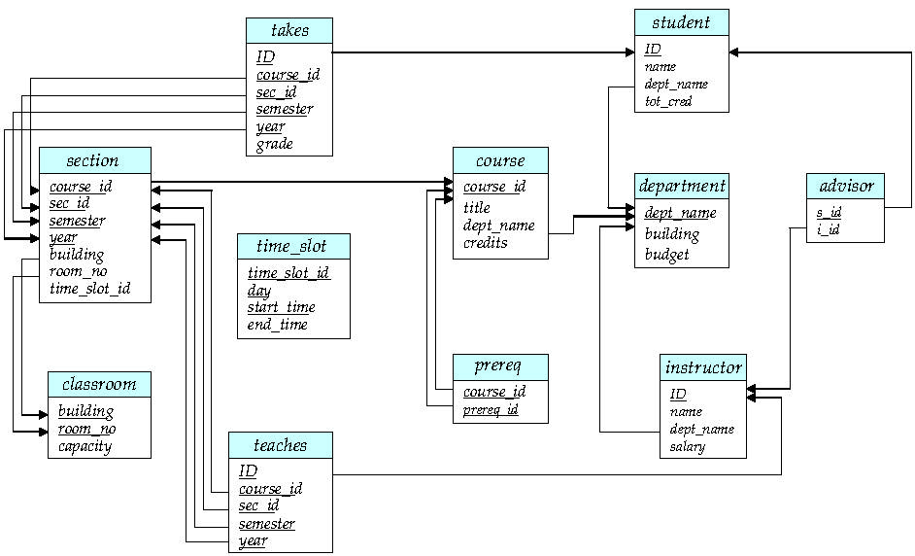
Schema Diagram for University Database

